Slide 1

PAHO’s Regional Revolving Funds
Linking Influenza to Vaccine Planning and Procurement
March 2026

Slide 2

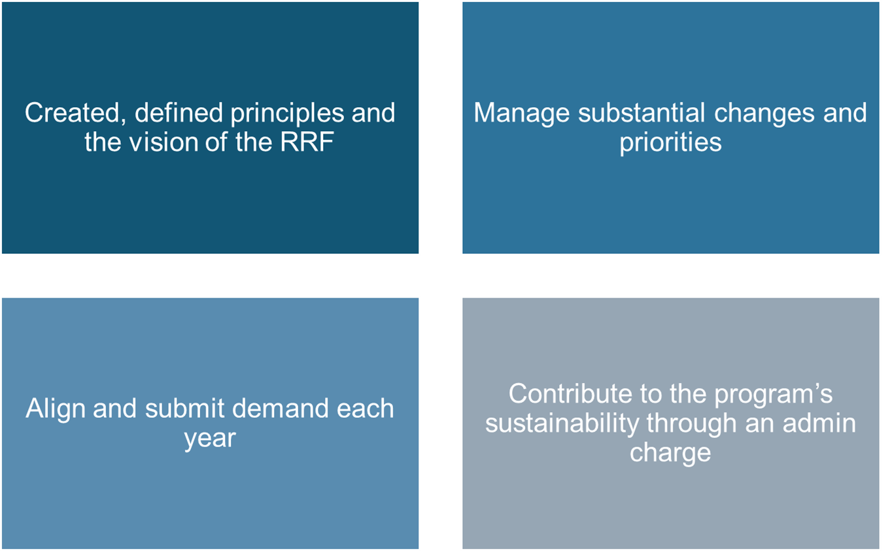
Political will is the backbone of RRF’s initiatives
PAHO Member States

Slide 3










































41 Countries and Territories buy through the Revolving Fund
Anguilla
Antigua & Barbuda
Argentina
Aruba
Bahamas
Barbados
Bermuda
Belize
Bolivia
Brazil
BVI
Cayman Islands
Chile
Colombia
Costa Rica
Cuba
Curaçao
Dominica
Dominican Republic
Ecuador
El Salvador
Grenada
Guatemala
Guyana
Haiti
Honduras
Jamaica
Montserrat
Nicaragua
Panama
Paraguay
Peru
St. Kitts & Nevis
St. Lucia
St. Marteen
St. Vincent & the Grenadines
Suriname
Trinidad & Tobago
Turks &
Caicos
Uruguay
Venezuela

Slide 4
Importance of Effective Demand Planning
Overcoming the Vicious Circle
Demand Uncertainty
Limited supply
Higher Prices
Influenza vaccines have unique market dynamics with seasonality and requiring careful demand planning
PAHO RF has critical role match demand with supply
Without timely and assured demand, it would be very risky for suppliers to commit to production
Demand changes would have detrimental impact on the market

Slide 5
Demand planning is a key enabler for catalyzing regional production efforts
Demand planning
Technical cooperation
Regulatory alignment
Logistics
Economies of scale
Negotiating power and operational efficiency
Coordination Monitoring
Unified criteria Simpler process
Decision-making Quantification
Alignment of buying cycles
Notes:
Annual routine demand is the basis process for everything else to flow.
Technical cooperation / decisión making. Quantification
Digital tools, efficiency
Regulatory pathway for products in the region, that unify criterio. Process is simpler for suppliers and countries.
Logistics coordination, monitoring.
Economies of scale.

Slide 6







Conventional Demand Planning Calendar
Initiating the Demand Planning Process
3- Regional Demand consolidation and analysis
5- Line of Credits are established and confirmed by Member States
7- Request for reconfirmation of demand for Q3 and Q4
9- Possible corrections and clarifications
1- Countries are asked on their initial vaccine needs.
JUN
JUL
JUL
AUG
SEP
OCT
OCTNOV
FEB
MAR
APR
MAY
Restart process
2- Countries present national demand plans
4- Possible corrections and clarifications
6- Cost Estimates based on country demand for Q1 and Q2
8- Demand consolidation and adjustments for Q3 and Q4

Slide 7
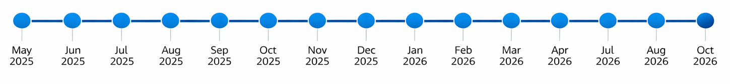
Influenza Annual Demand Planning Cycle
Provided forecasts to suppliers for production commitments
Deliveries for Q1-Q2
Deliveries for Q3-Q4
Consolidation of demand for the Region
2026 SH Season
2026 NH Season

Slide 8

Demand Planning and Procurement Execution Process
Payment
Quantification
Payment finalization
Technical Cooperation
Reception
Planning
Regional Demand
Consolidation
Logistics Time
Price
Estimate
Logistics
Purchase
order
Production Time
Pre Payment or Payment Commitment

Slide 9
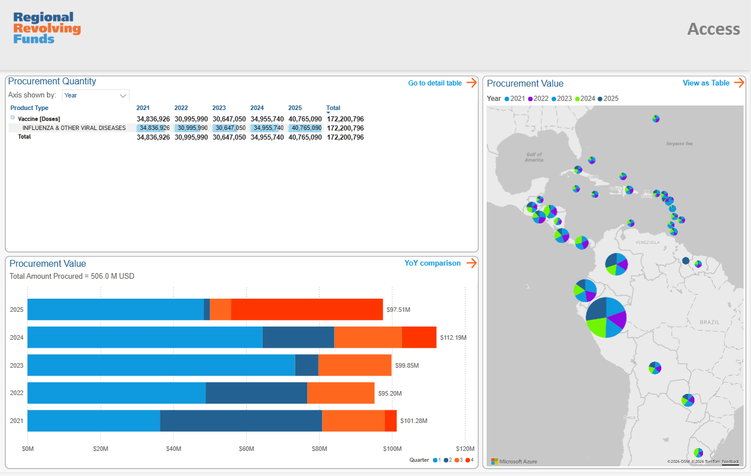
Influenza Summary
31 Member States purchased Influenza during 2025
Around
30 M
Vaccine doses of Influenza
Significant increase in supply during 2025 from Regional
Manufacturers, through the Fund

Slide 10






Interdisciplinary approach
Country Offices
Technical Assistance Coordination with EPIs
Monitoring
Management
Procurement
Market Analysis
Demand Planning
Partnerships
Cross-team coordination
Strategic Communications
Procurement processes Logistics Tendering and contracting
Supplier management
Quality
Technical Areas
Point of contact for WHO-PQ Technical evaluation
Regulatory capacities
Collaboration throughout the life cycle of products
Technical Strategies Support to National Programs
Finance
Legal
Credit line holding and investment Accounting management Payment to manufacturers
Contracting support
Legal advice

Slide 11
Seasonal influenza critical annual cycles
Southern Hemisphere | Cycle | JAN | FEB | MAR | APR | MAY | JUN | JUL | AUG | SEP | OCT | NOV | DEC
 | Epidemiological Season
 | WHO |  |  |  |  |  |  |  |  | Recommendation
 | Manufacturers | Filling | Deliveries |  |  |  |  |  |  |  | Final Composition | Production
 | PAHO | Order Placing | Order Placing |  |  |  |  | Demand Consolidation |  |  |  |  | Order Placing
Northern Hemisphere | Cycle | JAN | FEB | MAR | APR | MAY | JUN | JUL | AUG | SEP | OCT | NOV | DEC
 | Epidemiological Seaon
 | WHO |  | Recommendation
 | Manufacturers |  |  | Final Composition | Production |  |  | Filling |  | Deliveries
 | PAHO |  |  |  |  |  |  | Order Placing | Order Placing | Order Placing

Slide 12
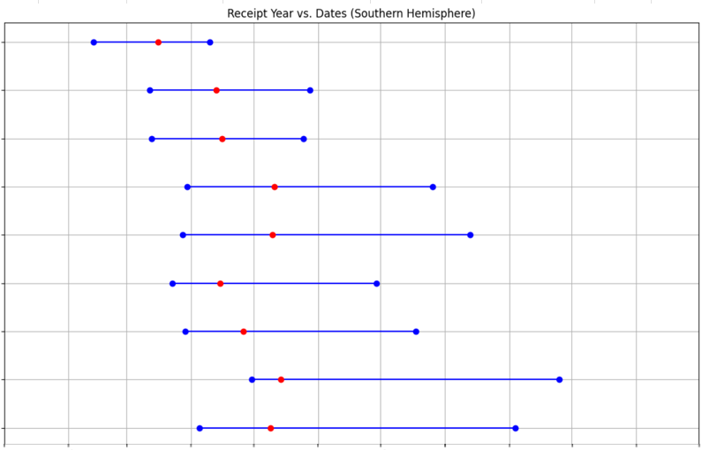
Influenza Vaccine Delivery Timelines
Southern Hemisphere
*
31M doses
2025
Based on supplier availability, demand planning choices of countries and epidemiological understanding, each season PAHO RF tries to optimize supply / demand matching.
Main objective is to ensure initial delivery of doses before start of the epidemiological weeks (can differ for each country).
2024
32M doses
2023
27M doses
2022
27M doses
2021
30M doses
2020
23M doses
2019
24M doses
2018
23M doses
2017
21M doses
Blue line: Delivery period range
Red dot: Weighted average delivery point based on volume per season
Jan
Feb
Mar
Apr
May
Jun
Jul
Aug
Sep
Oct
Nov
Dec

Slide 13
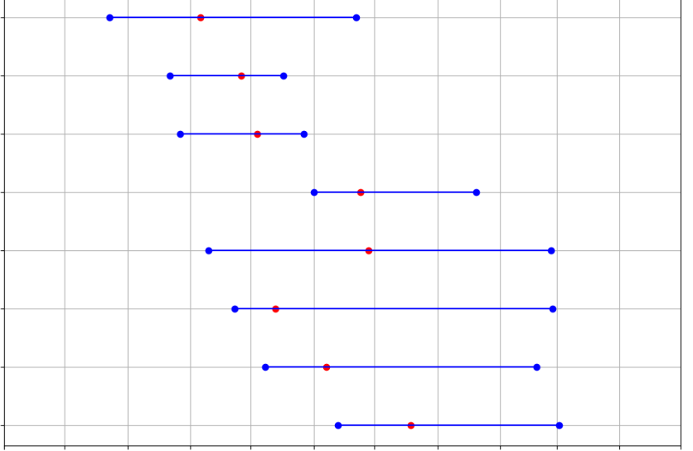
Influenza Vaccine Delivery Timelines
Northern Hemisphere
2024-2025
Based on supplier availability, demand planning choices of countries and epidemiological understanding, each season PAHO RF tries to optimize supply / demand matching.
Main objective is to ensure initial delivery of doses before start of the epidemiological weeks (can differ for each country).
2023-2024
2022-2023
2021-2022
2020-2021
2019-2020
2018-2019
2017-2018
Blue line: Delivery period range
Red dot: Weighted average delivery point based on volume per season
Jun
Jul
Aug
Sep
Oct
Nov
Dec
Jan
Feb
Mar
Apr
May

Slide 14




New Strategic Priorities of the Regional Revolving Funds
Regional Production
Establishment of regional supply agreements for rapid response
Optimization of processes and operational efficiency
Improvements in the product portfolio

Slide 15
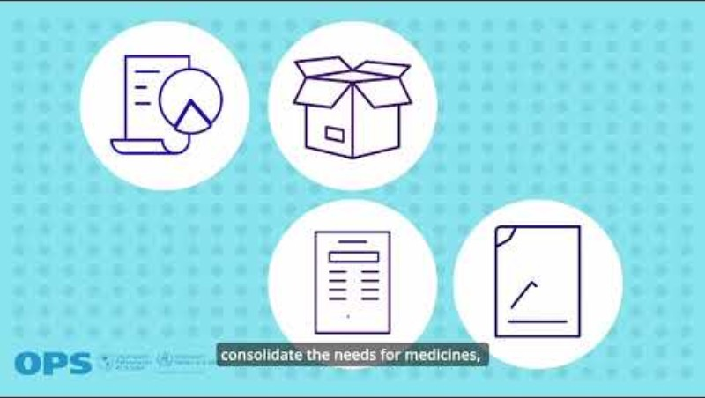
RRF’s Member States Portal

Slide 16





Rapid response to outbreaks and pandemics
Dose reservation of measles and yellow fever
It will be the first regional pandemic influenza agreement among middle-income countries in history.
Regional production
Use of seasonal influenza volumes to improve pandemic and seasonal conditions
Notes:
Lower prices, faster delivery times, and transfer of new technology

Slide 17
Latest Products in the Revolving Fund Portfolio
1
2
3
4
5
6
Hexavalent
(DTwP-Hib-HepB-IPV)
RSV
HPV 9
PCV 20
COVID 19
Dengue
PAHO’s impact in the market:
The prices of PCV20 do not place an additional burden on the immunization budget compared to current costs.
Hexavalent vaccine (wP) has a similar cost to pentavalent + IPV.

Slide 18








Key notes for continuous improvement:
Increased coordination at all levels (end to end)
Maximize the use of the MSP – Portal
Demand, Catalog, Finance, Purchase Orders
Timely processing of requisitions and purchase orders – including financial planning
Mapping supply chain actors in national offices and counterparts: roles and responsibilities
Commitment and solidarity from Member States is critical to ensure the sustainability of RRFs
Notes:
Mayor coordinación entre el área de compras y el área técnica en las oficinas
Compartir información entre equipos referente a dificultades o solicitudes para soluciones conjuntas particularmente dificultades relacionadas a la cadena de frío: Excursiones de temperatura, información de temperatura óptima, etc.
Involucramiento en el MSP
Creación de herramienta de monitoreo de órdenes
DC2024 – Soporte en implementación de modulo planeación de demanda en conjunto con parte técnica
Procesamiento oportuno de REQs
Comunicación debe agilizarse
Creación de canales de comunicación (áreas técnicas locales, HQ PRO, HQ SF)
Maximización Catalogo
No utilización de ítems viejos - eliminación productos inactivos
Utilización de ítems recientemente creados (fletes, seguros, etc.)
Mejora de flujo de creación de productos – Disminución de tiempos
Capacitacion e interpretación en Incoterms en los países
Mapeo actores de cadena de suministro en oficinas y contrapartes nacionales: roles y responsabilidades

Slide 19
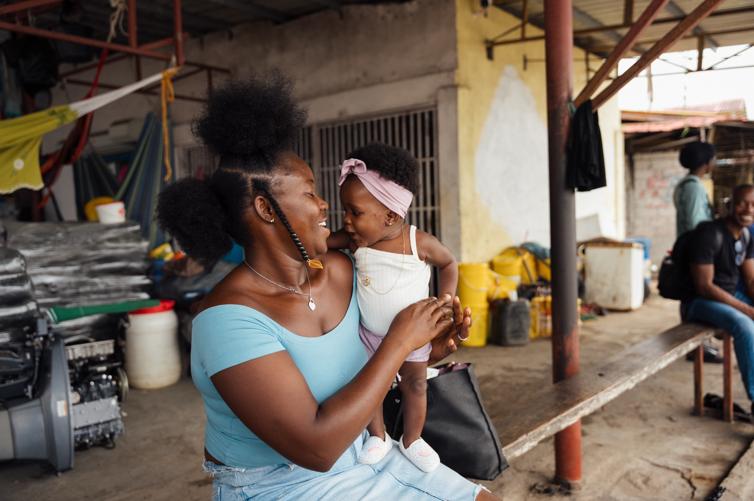

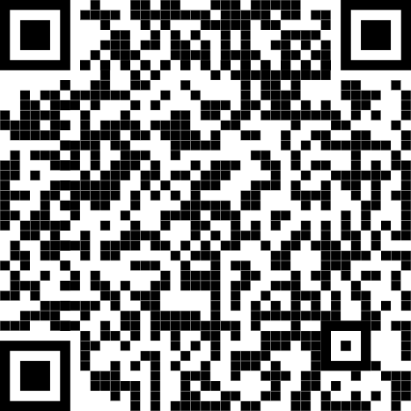

Thank you!

Slide 20
Procurement Process for the Revolving Fund
Procurement Strategy/ Sourcing/Tender
Consolidated demand
Strategy
ITB (Invitation to Bid-Tender)
Bid Analysis
Contract Review Committee (CRC)
Supply Agreement/Long Term Agreement
RFQ by country
Contact suppliers for quotation (RFQ)
Country, Quantity, Delivery Lead time, Shelf life, Packaging details, Freight/Insurance Cost, etc.
Proforma/Price Estimate
Country Approval
Purchase Order
PO Processing and Issuance
Copy sent to supplier and country
International Logistics
Shipment coordination
Incoterm DPU
Follow up with supplier and country for the shipping details and documents
Delivery to country
Allocation
Country demand is received and analyzed

Slide 21
Important Considerations for Seasonal Influenza Vaccines Demand Planning
Since these products are seasonal, you don’t need to provide stock information updates. Also, buffer stock considerations might not be pertinent like other regular vaccines.
It is very important to indicate different target groups accurately, especially for under 3 years old populations.
Different suppliers might have different volume indications for under 3 years old target groups (0.25 ml versus 0.5 ml per injection)
For children under 1 year old, 2 doses of influenza vaccination would be needed with 4 weeks apart. Children older than 1 year old might receive single dose influenza vaccine if they received 2 dose regime within one season previously.
For multi-dose products, it would be important to consider an appropriate estimate for wastage rate indication (as a national average).
For 1 dose vial, generally recommended minimum wastage rate estimate is 5%.
For 10 dose vial, the wastage rate would depend on country settings and recommended minimum values might range between 20% to 50%. Please note that multi-dose vial policy is applicable to almost all WHO pre-qualified seasonal influenza vaccines with multi-dose vial presentations.

Slide 22
Important Considerations for Demand Planning
High-Risk / Vulnerable Groups | Healthcare Workers
 | People with Comorbidities
 | Senior adults over (indicate age here) years old
 | Pregnant
 | Any other?
General Population | Adults (over 18 years) General Population
 | Adolescents (12 years to 17 years)
 | Pediatric (3 years to 11 years)
 | Pediatric (6 months - 3 years)
 | Any other?
4. It would be important to have a good mapping of high priority / vulnerable and general populations. Generally, procurement volumes of our Member States are not ideally covering high-risk / vulnerable groups.
5. It would be helpful to consider synergies with other seasonal products in demand planning like COVID vaccines, RSV vaccine (especially for pregnant) and RSV mAb etc.

